Slide 1
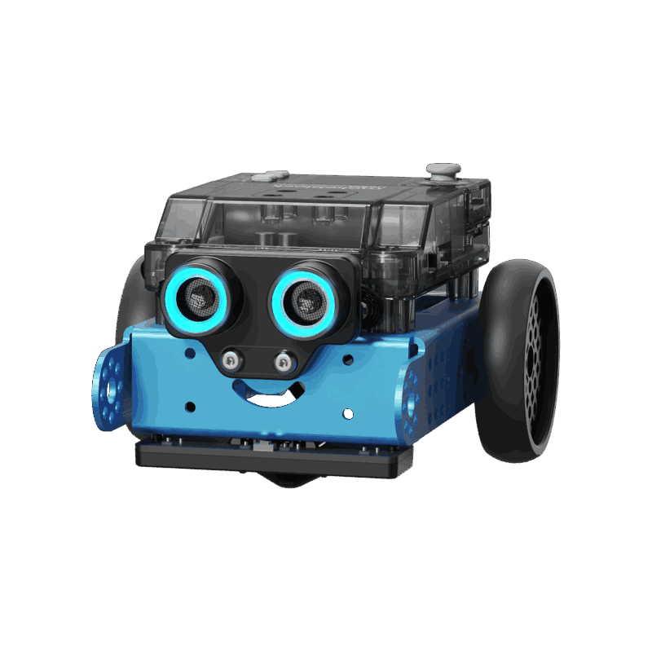
COSC-3070 Programming Autonomous Robot
Autonomous Path Following and Obstacle Avoidance With mBot Neo
Lecturer: Ginel Dorleon
Huynh Ngoc Tai (s3978680)
Tran Quang Minh (s3988776)
Chau Tung Nguyen (s3976069)
"I declare that in submitting all work for this assessment, I have read, understood and agree to the content and expectations of the assessment declaration".

Slide 2
Problem Overview

Slide 3
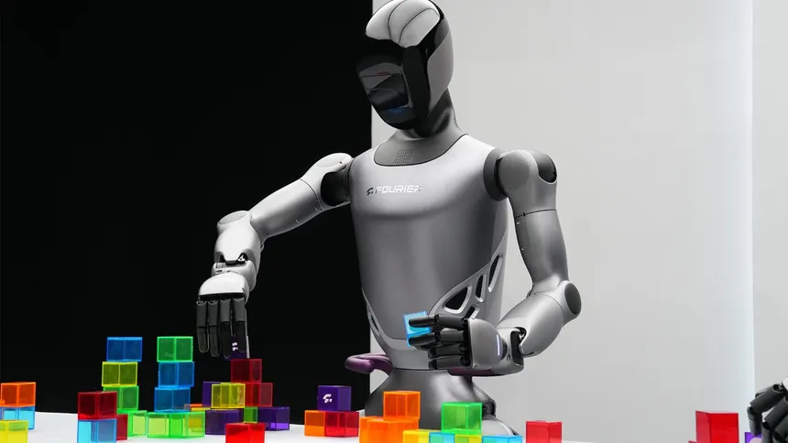
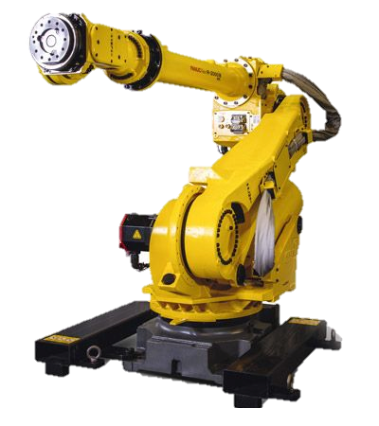
Problem Overview
Autonomous robots are revolutionizing industries like logistics and transportation.
They rely on AI, computer vision, and sensors to interpret paths, detect signs, and avoid obstacles.

Slide 4
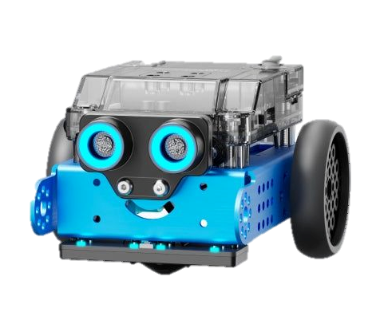
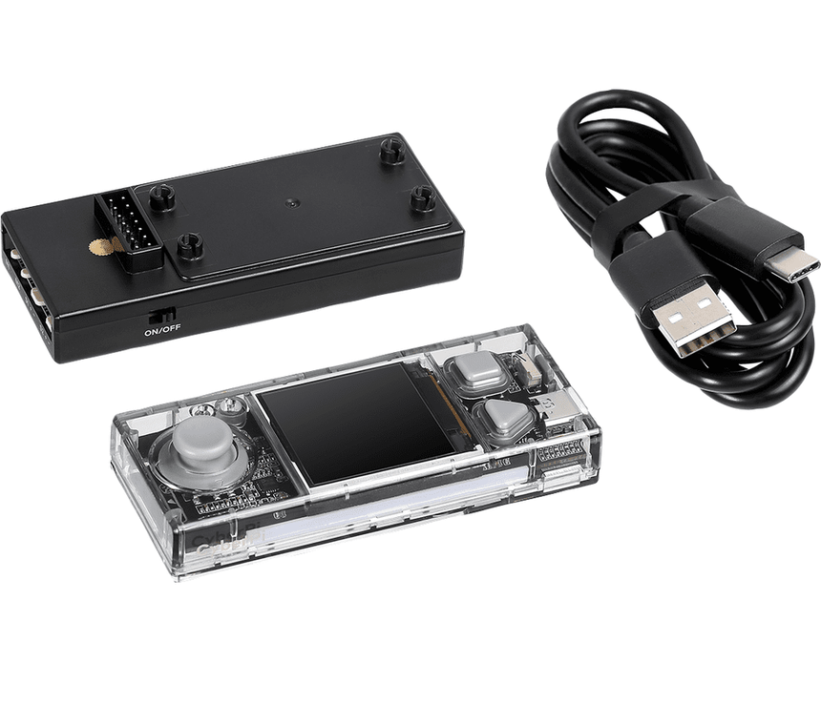
Problem Overview
For the final project of the course, we are given 2 things, which is :
- Cyber Pi is the microcontroller – the brain of the robot.
- mBot2 Neo is the complete robot – includes wheels, motors, sensors.
CODE

Slide 5
Project Setup

Slide 6
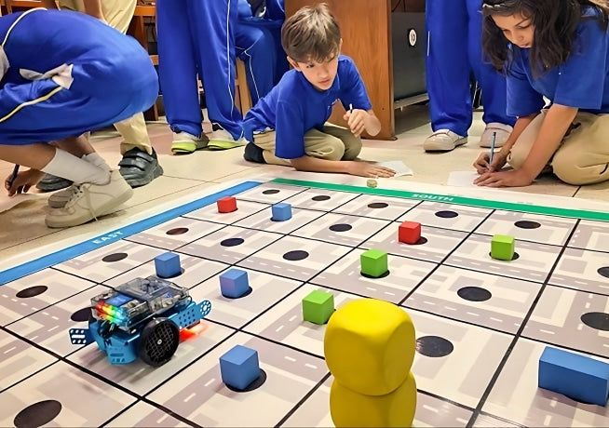
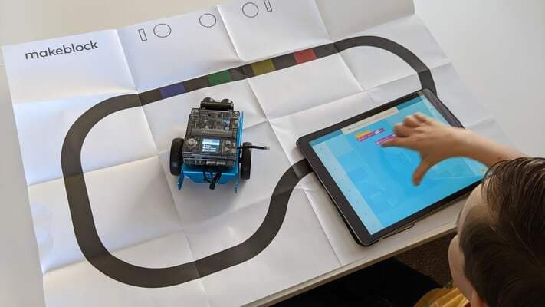
Problem Overview
The aim of the project is to simulate read-world autonomous robot using simple sensors and vision systems, which then the robot will need to successfully navigate a maze-like environment following and act accordingly to the signs it will sensor, or the obstacles along the way like an AI powered robot in the real world.

Slide 7
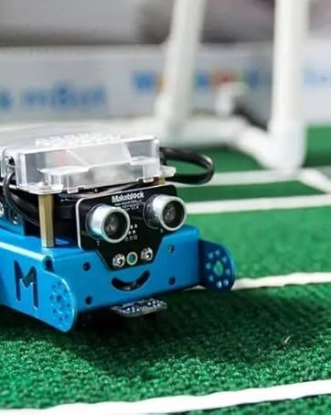
Problem Goal
For the demo, the robot must navigate a complex maze using only onboard logic, no remote control or intervention.
It follows traffic rules: stop on red, go on green, slow on yellow, and even handle combinations like yellow-to-green transitions. It must also avoid static obstacles automatically and reroute in T-junctions when needed.

Slide 8
Methodology Implementation

Slide 9
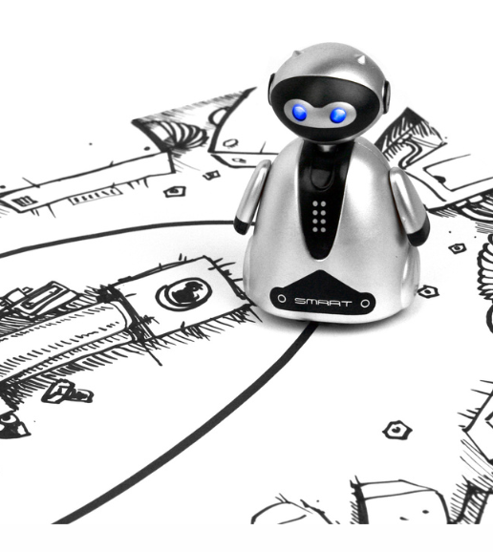

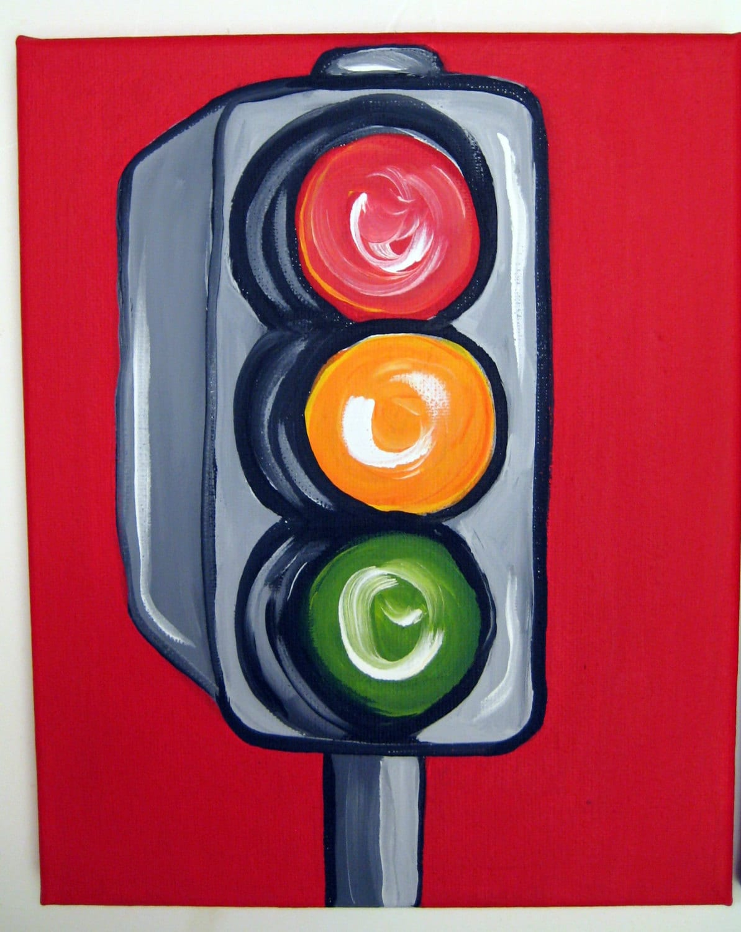
Methodology
Our method integrates three modules—path tracking, visual detection, and obstacle avoidance—into a unified loop.
Line tracking using RGB sensor
Obstacle detection with ultrasonic sensors
Visual sign detection with RGB sensor

Slide 10
System Initialization and Event Handling
Stop Mode
Wait for user to prompt
Triangle Button
Square Button
Start Running
JoyStick Button
Detect Colour Mode
Check For Anymore Input

Slide 11
Obstacle detection with ultrasonic sensors
Continue Running
Check if there’s anything in front of the car
Yes
Stop Running
No
Yes
Wait for 10s to see if obstacle is cleared
No
Turn 180 degree and run

Slide 12
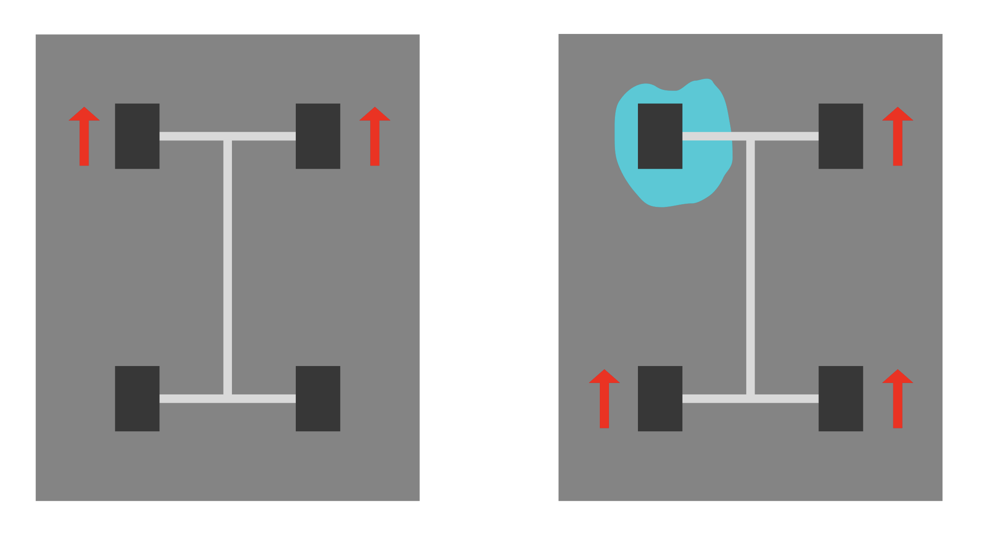
Line tracking using RGB sensor
base_power: the forward speed baseline
kp: proportional gain to control steering strength
offset: deviation from center line (negative = left, positive = right)
Motor speed formulas:
right_power = base_power - kp × offset
left_power = -1 × (base_power + kp × offset)

Slide 13

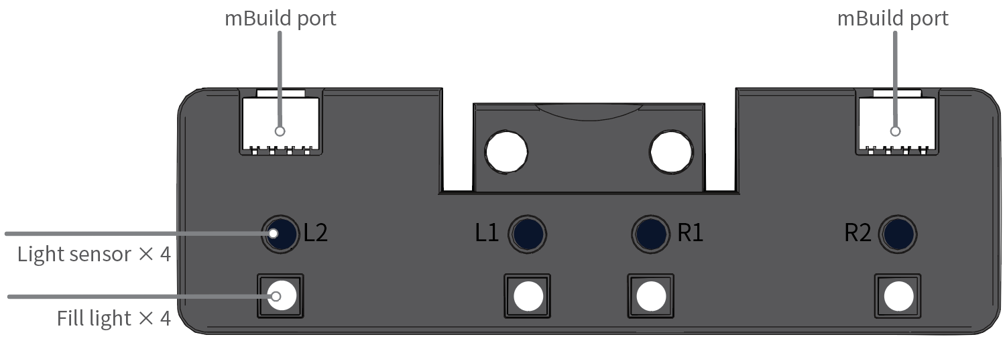
Visual sign detection with RGB sensor
Stop the car, will wait for 10 seconds then turn back
Slow the car
Will tell the car to run after being stopped by red light
Quad RGB sensor will check the colour of the sign under it to perform action accordingly

Slide 14



Implementation

Slide 15
In-Detailed Values for Implementation
Parameter | Value | Purpose
base_power | 30% PWM | Normal speed (~0.25 m/s)
base_power slow | 25% PWM | Caution zone speed (~0.20 m/s)
k_p | 0.3 | Proportional gain for smooth steering
Obstacle threshold | 15 cm | Safe stopping distance
Timeout duration | 10 seconds | Before rerouting
Turn angle | 190° | Prevents re-entering same blocked path

Slide 16
Creative Addon
Color Detected | Action | LED Feedback | Sound
Red | Stop completely, wait for green | Red | 261 Hz tone
Green | Resume motion at 30% PWM | Green | 659 Hz tone
Yellow | Slow to 25% PWM for 5 seconds | Yellow | 294 Hz tone
White | Continue line tracking at base speed | White | No tone

Slide 17
Testing

Slide 18
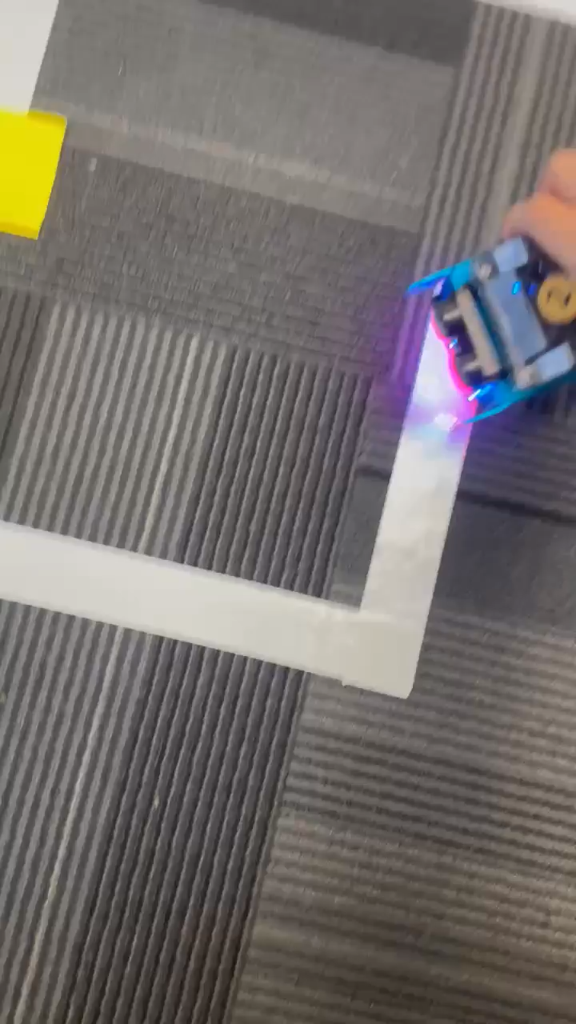
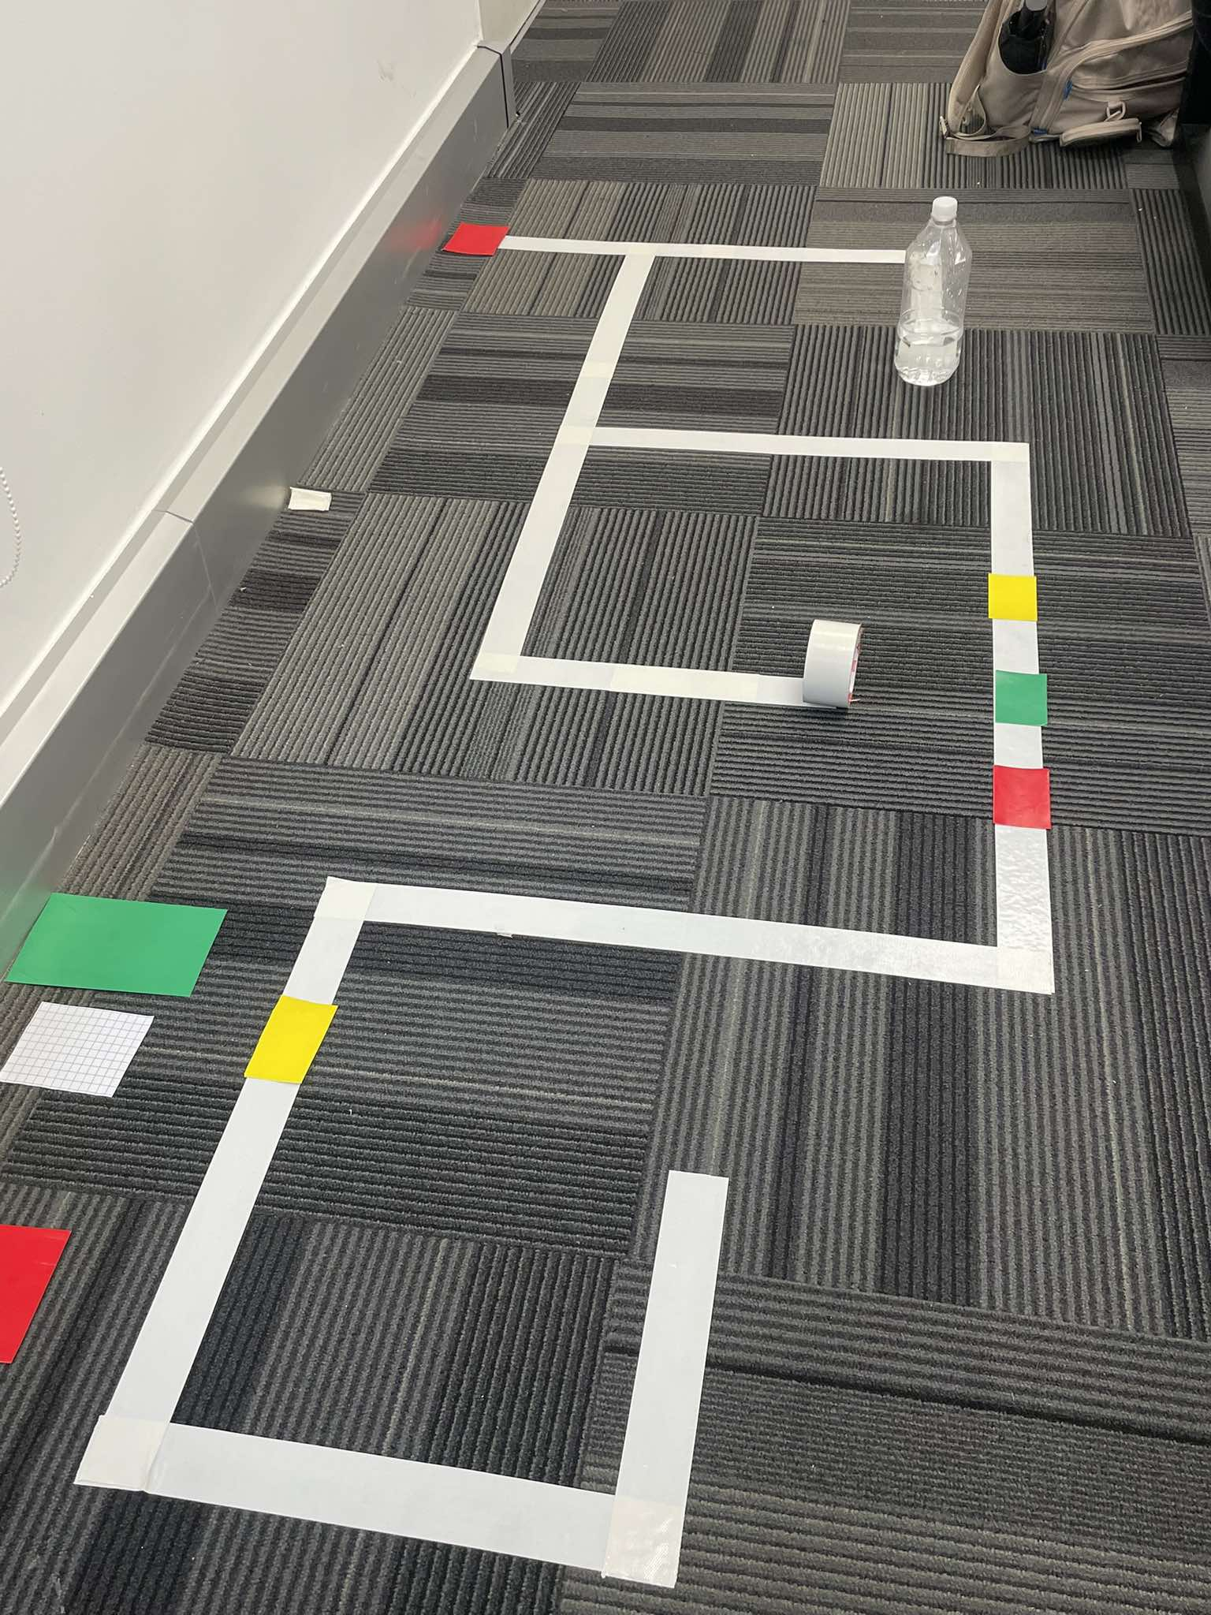
Testing
As per the requirement from the assignment, we decided to create a maze which satisfy most of the objectives the robot need to be able to do:
Avoid obstacle
Perform sign actions
Navigate when it meets T turn
….

Slide 19
Result, Evaluation and Conclusion

Slide 20
Result, Evaluation and Conclusion
Successfully completed tasks with decent-performing models.
The robot responded correctly to all sign-based instructions
Obstacle avoidance worked reliably under varied layouts.
Minor challenges like lighting and alignment drift were resolved through recalibration and logic tuning.

Slide 21
Challenges
While yellow slows the robot and green resumes it, the logic for maintaining speed for the first GREEN transition then speeding up at the second GREEN was not explicitly coded as we only have 5 seconds for the slowdown time.
If an obstacle partially blocks the path, the robot does not drift laterally to rejoin; it instead waits and turns
The robot does not yet evaluate both directions at a T intersection to select an available path, it will perform a single pivot if blocked

Slide 22
COSC-3070 Programming Autonomous Robot
Autonomous Path Following and Obstacle Avoidance With mBot Neo
THANK YOU FOR LISTENING TO OUR PRESENTATION AND WISH YOU A NICE DAY
"I declare that in submitting all work for this assessment, I have read, understood and agree to the content and expectations of the assessment declaration".

